Slide 1
MONICA . B
Final Project
3/21/2024 Annual Review

Slide 2
PROJECT TITLE
DEVELOPING AN ARTIFICIAL INTELLIGENCE SYSTEM FOR ANALYSING THE CV AND PREDICTING THE PERSONALITY OF AN APPLICANT.
3/21/2024 Annual Review

Slide 3


AGENDA
1.Introduction and Overview
2.Research and Requirements Gathering
3.Data Collection and Preparation
4.Algorithm Selection and Development
5.System Architecture and Implementation
6.User Interface Design and Development
7.Deployment and Deployment Strategy
8.Testing and Evaluation
9.Monitoring and Maintenance
10.Documentation and Knowledge Sharing
11.Conclusion and Future Directions
This project agenda provides a structured outline for developing an AI system focused on curriculum vitae traversal and covering various stages from research and requirements gathering to deployment and maintenance
3/21/2024 Annual Review

Slide 4

PROBLEM STATEMENT
Develop an artificial intelligence system,
that can use a machine learning model to predict personality traits from resumes (CVs) using natural language processing techniques. The model should analyze textual data from CVs to infer traits such as extroversion, conscientiousness, openness, agreeableness, and neuroticism, providing insights for employers to better understand candidates' suitability for specific roles.
3/21/2024 Annual Review

Slide 5

PROJECT OVERVIEW
The Personality Prediction through CV Analysis project aims to develop a machine learning system capable of predicting personality traits of individuals based on the analysis of their resumes (CVs). By leveraging natural language processing (NLP) techniques and machine learning algorithms, this project seeks to provide insights into candidates' personalities, facilitating more informed hiring decisions for employers.
1. Develop a pipeline for parsing and preprocessing CV data: The project will involve extracting textual information from CV documents and preprocessing the data to prepare it for analysis.
2. Define a set of target personality traits: Identify specific personality traits to be predicted, such as extroversion, conscientiousness, openness, agreeableness, and neuroticism.
3. Select appropriate NLP techniques and machine learning algorithms: Explore and evaluate various NLP techniques, feature extraction methods, and machine learning models suitable for personality prediction.
4. Train and fine-tune the predictive model: Utilize labeled datasets to train and optimize the machine learning model for accurate personality prediction.
5. Evaluate model performance: Assess the performance of the developed model using appropriate metrics and validation techniques to ensure reliability and generalization capability.
6. Develop a user-friendly interface: Create an intuitive interface to allow users, such as employers or HR professionals, to upload CVs and obtain personality trait predictions easily.
3/21/2024 Annual Review

Slide 6
Expected Outcomes:
A trained artificial intelligence model capable of predicting personality traits from CV data with reasonable accuracy.
An intuitive user interface for uploading CVs and obtaining personality trait predictions.
Insights into the potential correlations between linguistic features in CVs and personality traits, contributing to the understanding of human behavior in professional contexts.
Conclusion:
The Personality Prediction through CV Analysis project aims to leverage machine learning and NLP techniques to enhance the hiring process by providing insights into candidates' personalities based on their CVs. By automating personality trait prediction, this project has the potential to streamline recruitment processes and improve candidate-job fit assessments for employers.

Slide 7

WHO ARE THE END USERS?
1. Human Resource Professionals: HR professionals in various industries can utilize the personality prediction system to assess the suitability of candidates for specific roles, streamline the recruitment process, and improve candidate-job fit.
2. Recruitment Agencies: Recruitment agencies can leverage the personality prediction tool to enhance their candidate screening processes, offer more tailored candidate recommendations to clients, and improve overall client satisfaction.
3. Hiring Managers: Hiring managers responsible for selecting candidates for job openings can benefit from the personality prediction system to gain insights into candidates' personalities and make more informed hiring decisions.
4. Talent Acquisition Teams: Talent acquisition teams within organizations can use the personality prediction tool to identify candidates who align with the organization's culture, values, and job requirements, thereby improving employee retention and performance.
5. Career Counselors: Career counselors and advisors can utilize the personality prediction system to provide personalized career guidance to individuals based on their personality traits and strengths, helping them make informed career decisions.
6. Job Seekers: Job seekers can use the personality prediction tool to gain insights into how their personality traits may be perceived by potential employers and tailor their CVs accordingly to enhance their job prospects.
3/21/2024 Annual Review

Slide 8
7. Psychologists and Researchers: Psychologists and researchers studying personality traits and their impact on professional success can use the personality prediction system to gather data and insights for their studies, contributing to the advancement of knowledge in the field of psychology and human resources.
8. Educational Institutions: Career services departments in educational institutions can integrate the personality prediction tool into their career counseling and job placement services to assist students and alumni in identifying suitable career paths and job opportunities.
9. Corporate Trainers and Coaches: Corporate trainers and coaches can utilize the personality prediction system to customize training programs and coaching sessions based on participants' personality profiles, enhancing learning outcomes and professional development.
10. Job Boards and Career Websites: Job boards and career websites can incorporate the personality prediction tool as an additional feature to provide value-added services to job seekers and employers, improving user engagement and satisfaction.

Slide 9

YOUR SOLUTION AND ITS VALUE PROPOSITION
The developed system solves the problems of various end user’s as
Improved Candidate Screening: By analyzing personality traits from CVs, the system helps in filtering candidates based on their suitability for specific roles beyond just qualifications and experience. This allows recruiters to focus on candidates who not only meet the job requirements but also possess the desired personality traits for success in the role.
Enhanced Candidate-Role Alignment: The system facilitates a better understanding of how well candidates' personalities align with the job requirements and organizational culture. This ensures that candidates selected for further consideration are more likely to thrive in the role, leading to higher job satisfaction and performance.
Reduction in Bias: By relying on objective data derived from CVs, the system helps mitigate unconscious biases that may influence traditional CV screening processes. Personality prediction adds an additional layer of objectivity to the screening process, leading to fairer and more inclusive hiring decisions.
Time and Cost Savings: Automating the personality prediction process streamlines CV screening, saving valuable time and resources for recruiters and hiring managers. By prioritizing candidates with the most suitable personality traits, the system reduces the need for manual review of numerous CVs, accelerating the hiring process.
Enhanced Candidate Experience: Candidates benefit from a more personalized and relevant screening process. Rather than being evaluated solely based on qualifications, candidates are assessed holistically, leading to a more positive candidate experience and increased likelihood of attracting top talent.
3/21/2024 Annual Review

Slide 10
Increased Hiring Success Rate: By ensuring that candidates selected for further consideration possess not only the required skills but also compatible personality traits, the system improves the likelihood of hiring successful candidates who are a good fit for the role and the organization. This contributes to reduced turnover rates and improved long-term retention.
Overall, the system's ability to predict personality traits from CVs adds significant value to the hiring process by enabling more informed and objective candidate screening, improving candidate-role alignment, reducing bias, saving time and costs, enhancing candidate experience, and ultimately increasing hiring success rates.

Slide 11

THE WOW IN YOUR SOLUTION
Holistic Candidate Assessment: The project offers a revolutionary approach to candidate assessment by analyzing not only qualifications and experiences but also personality traits extracted from CVs. This holistic evaluation provides recruiters with a more comprehensive understanding of candidates, ensuring that those selected for further consideration are not only skilled but also well-suited to the role and organizational culture.
Data-Driven Decision Making: By leveraging machine learning and natural language processing techniques, the project empowers recruiters to make data-driven hiring decisions. Personality predictions derived from CVs offer objective insights, reducing reliance on subjective judgments and mitigating unconscious biases in the screening process. This fosters fairer and more inclusive recruitment practices.
Streamlined Recruitment Process: Implementing the personality prediction system streamlines the recruitment process by automating candidate screening and prioritizing candidates with the highest potential for success. This efficiency translates into significant time and cost savings for hiring teams, allowing them to focus their resources on engaging with top-quality candidates and facilitating smoother hiring experiences for both employers and job seekers.
3/21/2024 Annual Review
11

Slide 12
MODELLING
Welcome Screen
User Input Field.
Bot Response Area: This is where the chatbot's responses appear. It might include text responses as well as interactive elements like buttons or quick replies for the user to choose from.
Menu or Navigation: Depending on the complexity of the chatbot, there might be a menu or navigation bar that allows the user to access different features or sections of the chatbot related to financial crisis management.
5.Feedback Mechanism: A way for the user to provide feedback on the chatbot's responses or overall experience, which can help improve the system performance over time.
Remember, wireframes are usually simplified representations of the interface, focusing more on functionality and structure rather than detailed design elements.
Personality prediction based on a curriculum vitae (CV) is a burgeoning field leveraging machine learning algorithms to infer traits from textual and visual cues. By analyzing linguistic patterns, job experiences, and extracurricular activities listed in a CV, predictive models can estimate an individual's personality traits such as extraversion, conscientiousness, and openness to experience. Additionally, incorporating profile images can enhance prediction accuracy by capturing facial expressions and non-verbal cues. These predictive models offer valuable insights for talent acquisition, career counseling, and personalized recommendation systems. As the technology advances, the integration of multimodal data promises more nuanced personality assessments, facilitating better understanding of human behavior and preferences.
3/21/2024 Annual Review
12

Slide 13
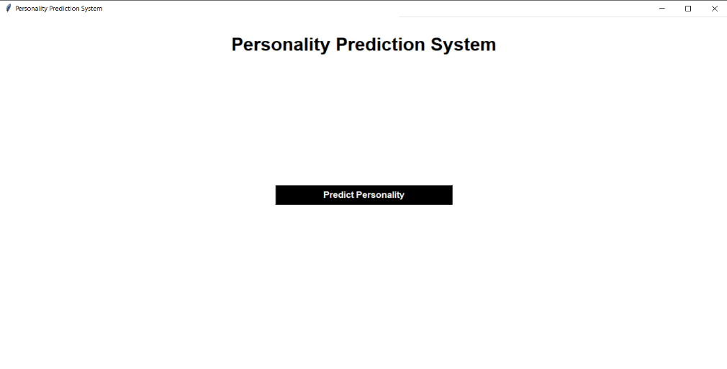
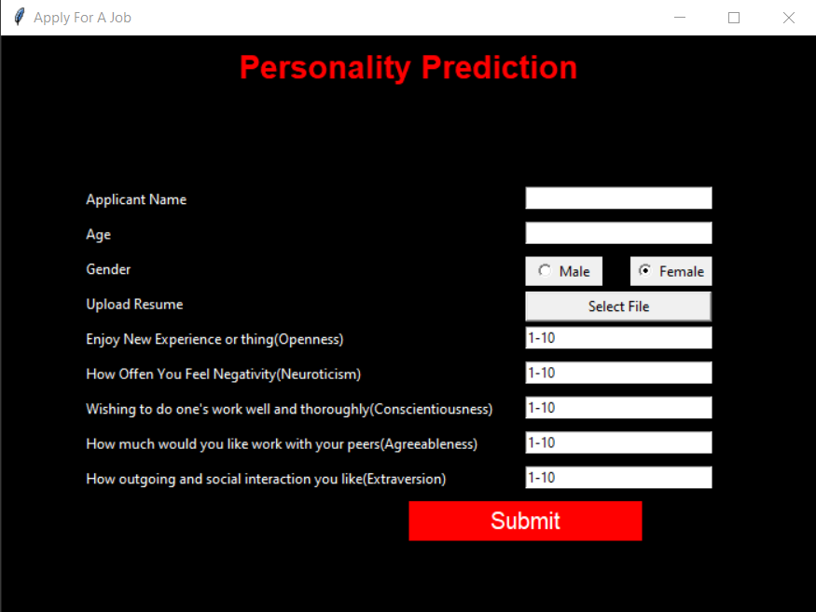
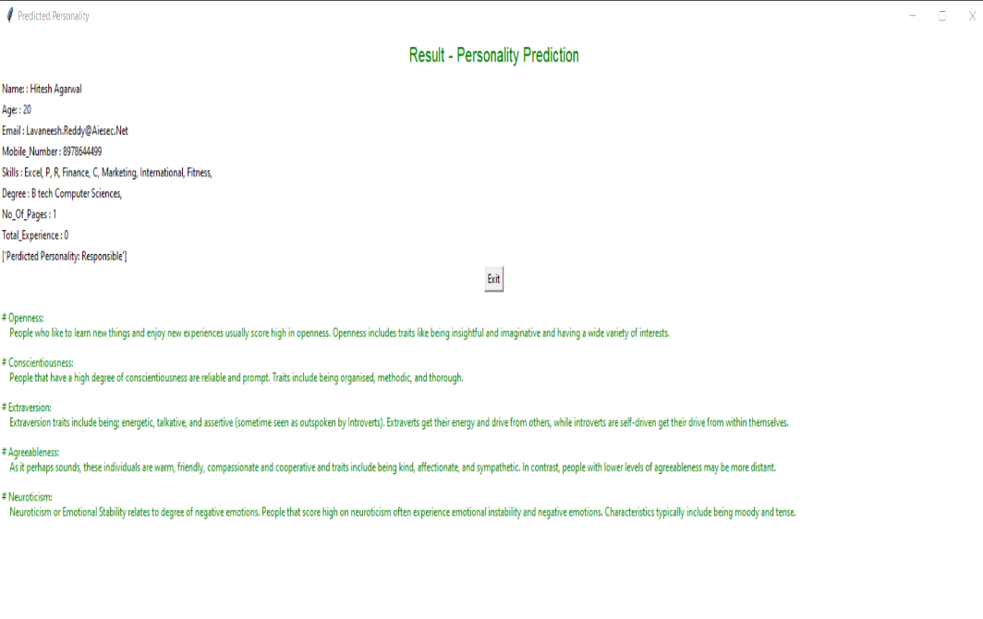
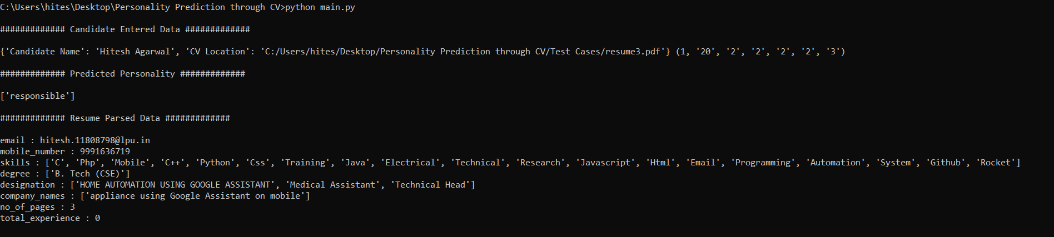

Slide 14
RESULTS
The project conclusion for a system that predicts personality from CVs and its impact on the hiring process could be summarized as follows:
Enhanced Hiring Efficiency: The system significantly streamlines the hiring process by providing recruiters with valuable insights into candidates' personalities directly from their CVs. This eliminates the need for extensive interviews or personality assessments, saving time and resources for both the hiring team and the candidates.
Improved Candidate Matching: By leveraging personality prediction algorithms, the system facilitates better candidate-organization alignment. Recruiters can identify individuals whose personalities align with the company culture and job requirements more accurately, leading to higher job satisfaction and retention rates.
Reduced Bias: Traditional hiring processes are prone to unconscious biases, which can result in discriminatory practices. By relying on objective data extracted from CVs, the system helps mitigate bias and promotes a fairer evaluation of candidates based on their skills, qualifications, and personality traits.
Predictive Insights: The system offers predictive capabilities by analyzing historical data on successful hires and correlating them with personality traits. This enables recruiters to make data-driven decisions and forecast a candidate's potential performance and fit within the organization more accurately.
3/21/2024 Annual Review
14

Slide 15
Cost Savings: With a more efficient and effective hiring process, organizations can realize significant cost savings associated with reduced recruitment time, decreased turnover rates, and improved productivity resulting from better employee-organization fit.
Continuous Improvement: Continuous monitoring and refinement of the system ensure that it evolves with changing hiring trends and organizational needs. Regular updates based on feedback and performance metrics ensure its relevance and effectiveness in the long run.
In conclusion, the system that predicts personality from CVs revolutionizes the hiring process by providing recruiters with actionable insights, enhancing efficiency, reducing bias, and ultimately leading to better candidate-organization matches and improved business outcomes.
https://github.com/MONICASHREEJA/TNSDC_Generative-AI

